Slide 1

Virtualization
Computer System Principles, Fall 2020 (IPADS, SJTU)
Virtualizing CPU, Memory and Devices
Yubin Xia

Slide 2
When Do You Use Virtual Machine?
VM in daily-use:
  Debug, especially for OS
  Sandbox some untrusted apps
VM can also be used to:
  Multiplex physical machine, e.g., in cloud
  Deploy complex software in a VM image
  Make multiple machines look like one
  Enhance security, fault tolerance, etc.

Slide 3
Review: OS Structure
OS
App
Logic
User-Mode
Kernel-Mode
DOS
UNIX
MicroKernel
ExoKernel
Notes:
Q1: what are difference? Consider file system, page fault handler, device driver, cpu scheduling
Q2: what is address space? Note that the kernel and apps share the same space
Q3: which one has the best performance
Q4: what is virtual machine’s architecture? Both Xen and KVM

Slide 4
Virtualization Layers
At which layer?
  Hello world
  Web game
  Dota
  Office 2013
  Windows 8
  Java applications
  Python scripts
  High Sierra
API
Applications
Libraries
System Calls
ABI
Operating
System
ISA
System ISA
User ISA
Hardware
API – application programming interface
ABI – application binary interface
ISA – instruction set architecture

Slide 5
What is a VM and Where is the VM?
Machine from the perspective of a system
  ISA provides interface between system and machine
Application
Programs
Libraries
Application Software
Operating System
Drivers
Memory
Manager
Scheduler
Operating System
Execution Hardware
Memory
Translation
System ISA
User ISA
System Interconnect (Bus)
ISA
Controllers
Controllers
Machine
IO Devices,
Networking
Main Memory

Slide 6
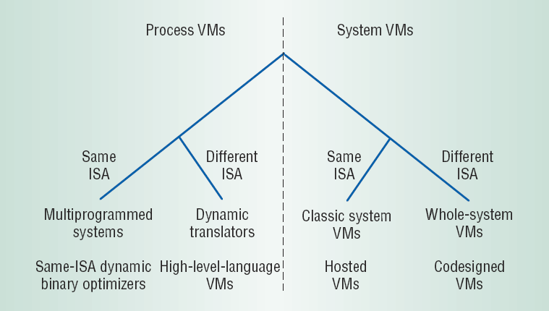
Design Space (Level vs. ISA)
API Interface
ABI Interface

Slide 7
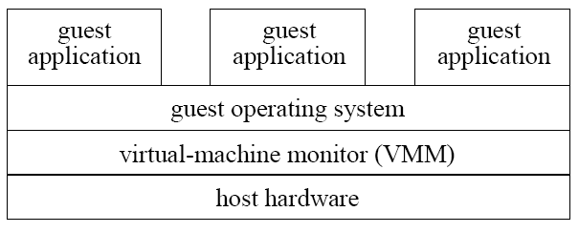
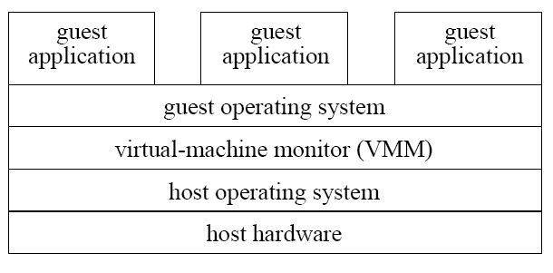
System VMMs
Type 1
Type 1: runs directly on hardware
  High performance
  e.g., Xen, VMware ESX Server
Type 2: runs on Host OS
  Ease of construction/installation
  e.g., VMware Workstation
Type 2

Slide 8
VMM (Virtual Machine Monitor)
Why do we need a VMM?
  For managing VMs which running guest OS
  VMM runs underlying VMs (higher privilege)
Virtualize hardware
  CPU
  Memory
  Device
App-1
App-2
VM-1
VM-2
VM-3
Guest OS
VMM
CPU
Mem
Device

Slide 9
Different Architectures of VMM
VM-1
VM-2
VM-1
VM-2
VM-1
VM-2
VMM
VMM
VMM
Host OS
Host OS
VMM
Hardware
Hardware
Hardware
Xen
Linux KVM
Qemu

Slide 10
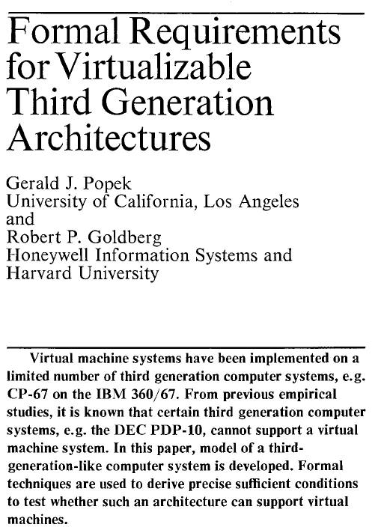
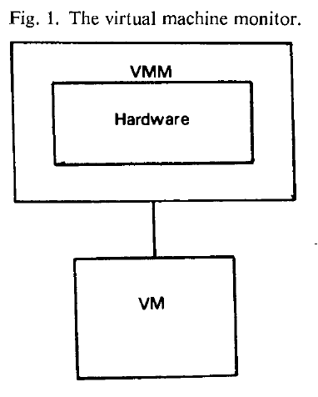
Principles in 1974
"an efficient, isolated duplicate of the real machine"
Efficiency
  Innocuous instructions should execute directly on hardware
Resource control
  Executed programs may not affect the system resources
Equivalence
  The behavior of a program executing under the VMM should be the same as if the program were executed directly on the hardware (except possibly for timing and resource availability)
Communications of the ACM, vol 17, no 7, 1974, pp.412-421

Slide 11
CPU Virtualization

Slide 12
What are the Differences between OS & VMM?
Similarities
  Multiplex hardware
  Higher privilege
Differences
  Different abstraction
  VMM schedules VMs, OS schedules processes
App-1
App-2
App-3
VM-1
VM-2
VM-3
OS
VMM
CPU
Mem
Device
CPU
Mem
Device

Slide 13
CPU Virtualization: Process and VM
Each process thinks it has the entire CPU
  Does not care other processes
OS schedules the processes
  OS splits the CPU time to time-slices
  Schedule each process preemptively
  Save context, find next, restore context
Why not run a VM as a process?

Slide 14
First Try: OS on OS
Run as an application!
Guest VM
Guest OS
Guest App-1
Guest App-2
Host App-1
Host App-2
User mode
Kernel mode
Host OS
(Now works as VMM)
CPU
Mem
Device

Slide 15
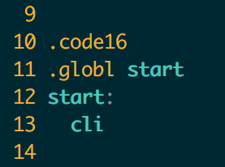
Run OS as an Application
Stuck at the very first instruction
  cli : disable interrupt
  It’s a privilege instruction
  Cannot run in user mode!
Similar instructions
  E.g., change CR3, set IDT, etc.
  These instructions will change machine states
xv6: bootasm.S

Slide 16
Challenges to Virtualized System ISA
Guest OS-1
Guest OS-2
Guest OS-3
Guest OS-4
Mov $100, CR3
Mov $80, CR3
Mov $120, CR3
Mov $200, CR3
Host OS
CPU
Mem
Device
Guest OS executes privilege instructions
Guest OS are not allowed to run the privilege instructions

Slide 17
Solution: Trap & Emulate
Trap: running privilege instructions will trap to the VMM
Emulate: those instructions are implemented as functions in the VMM
System states are kept in VMM’s memory, and are changed according
Guest OS-1
Guest OS-2
Guest OS-3
Trap
Mov $100, CR3
Host OS
Emulate
Mov $20, CR3
CPU
Mem
Device

Slide 18
Now We Can Run OS as an Application
Host OS virtualizes system states
  Save guest system states in memory
When a guest OS runs cli
  CPU will trap to the host OS (trap)
  Host OS will change the IF bit (emulate)
How does a host OS deliver interrupt to a guest OS?
  Similar as delivering a signal to an application
Problem solved? No...
xv6: bootasm.S

Slide 19
Problems of Trap & Emulate
Not all architectures are "strictly virtualizable"
An ISA is strictly virtualizable if, when executed in a lesser privileged mode:
  All instructions that access privileged state trap
  All instructions either trap or execute identically
Trap costs may be high

Slide 20
X86 is not Strictly Virtualizable
Example: the popf instruction
  popf takes a word off the stack and puts in into the flags register
    One flag in that register is the interrupt enable flag (IF)
  At system level the IF flag is updated by popf
  At user level the IF flag is not updated, and CPU silently drops updates to the IF
There 17 such instructions in X86
  SGDT, SIDT, SLDT, SMSW, PUSHF, POPF, LAR, LSL, VERR, VERW, POP, PUSH, CALL, JMP, INT n, RET, STR, MOV

Slide 21
How to Deal with the 17 Instructions?
Instruction Interpretation: emulate them by software
Binary translation: translate them to other instructions
Para-virtualization: replace them in the source code
New hardware: change the CPU to fix the behavior

Slide 22
Sol-1: Instruction Interpretation
Emulate Fetch/Decode/Execute pipeline in software
  Emulate all the system status using memory
    E.g., using an array GPR[8] for general purpose registers
  None guest instruction executes directly on hardware
E.g., Bochs

Slide 23
Example: Virtualizing Interrupt Flag w/ Instruction Interpreter
void CPU_Run(void)
{
while (1) {
inst = Fetch(CPUState.PC);
CPUState.PC += 4;
switch (inst) {
case ADD:
CPUState.GPR[rd] = GPR[rn] + GPR[rm];
break;
…
case CLI:
CPU_CLI(); break;
case STI:
CPU_STI(); break;
}
if (CPUState.IRQ && CPUState.IE) {
CPUState.IE = 0;
CPU_Vector(EXC_INT);
}
}
}
void CPU_CLI(void)
{
CPUState.IE = 0;
}
void CPU_STI(void)
{
CPUState.IE = 1;
}
void CPU_Vector(int exc)
{
CPUState.LR = CPUState.PC;
CPUState.PC = disTab[exc];
}

Slide 24
Instruction Interpretation
Positives
  Easy to implement & minimal complexity
Negatives
  Very slow!

Slide 25
Sol-2: Binary Translator
Translate before execution
  Translation unit is basic block (why?)
  Each basic block -> code cache
  Translate the 17 instructions to function calls
    Implemented by the VMM
E.g., VMware, Qemu

Slide 26
Architecture of a Binary Translator
Guest
Code
Translator
TC
Index
Translation
Cache
CPU Emulation
Routines
Callouts

Slide 27
Basic Blocks
Guest Code
vPC
mov ebx, eax
cli
and ebx, ~0xfff
Straight-line code
Basic Block
mov ebx, cr3
sti
ret
Control flow

Slide 28
Binary Translation
Guest Code
Translation Cache
vPC
mov ebx, eax
mov ebx, eax
start
cli
call HANDLE_CLI
and ebx, ~0xfff
and ebx, ~0xfff
mov ebx, cr3
mov [CO_ARG], ebx
sti
call HANDLE_CR3
ret
call HANDLE_STI
jmp HANDLE_RET
Notes:
Dynamic binary translation is used in virtualizing the CPU by translating potentially dangerous (or non-virtualizable) instruction sequences one-by-one into safe instruction sequences.
It works like this:
The monitor inspects the next sequence of instructions. An instruction sequence is typically defined as the next basic block, that is all instructions up to the next control transfer instruction such as a branch. There may be reasons to end a sequence earlier or go past a branch but for now lets assume we go to the next branch.
Each instruction is translated and the translation is copied into a translation cache.
Instructions are translated as follows:
Instructions which pose no problems can be copied into the translation cache with modification. We call these "ident" translations.
Some simple dangerous instructions can be translated into a short sequence emulation code. This code is placed directly into the translation cache. We call this "inline" translation. An example is the modification of the Interrupt Enable flag.
Other dangerous instructions need be performed by emulation code in the monitor. For these instructions calls to the monitor are made. These are called "Call-outs". An example of these is a change to the page table base.
The branch ending the basic block needs a call out.
The monitor can now jump to the start of the translated basic block with the virtual registers in the hardware registers.
So dangerous instructions can be privileged instructions, non-virtualizable instructions, control flow, memory accesses.

Slide 29
Binary Translation
Guest Code
Translation Cache
vPC
mov ebx, eax
mov ebx, eax
start
cli
mov [CPU_IE], 0
and ebx, ~0xfff
and ebx, ~0xfff
mov ebx, cr3
mov [CO_ARG], ebx
sti
call HANDLE_CR3
ret
mov [CPU_IE], 1
test [CPU_IRQ], 1
jne
call HANDLE_INTS
jmp HANDLE_RET
Notes:
Dynamic binary translation is used in virtualizing the CPU by translating potentially dangerous (or non-virtualizable) instruction sequences one-by-one into safe instruction sequences.
It works like this:
The monitor inspects the next sequence of instructions. An instruction sequence is typically defined as the next basic block, that is all instructions up to the next control transfer instruction such as a branch. There may be reasons to end a sequence earlier or go past a branch but for now lets assume we go to the next branch.
Each instruction is translated and the translation is copied into a translation cache.
Instructions are translated as follows:
Instructions which pose no problems can be copied into the translation cache with modification. We call these "ident" translations.
Some simple dangerous instructions can be translated into a short sequence emulation code. This code is placed directly into the translation cache. We call this "inline" translation. An example is the modification of the Interrupt Enable flag.
Other dangerous instructions need be performed by emulation code in the monitor. For these instructions calls to the monitor are made. These are called "Call-outs". An example of these is a change to the page table base.
The branch ending the basic block needs a call out.
The monitor can now jump to the start of the translated basic block with the virtual registers in the hardware registers.
So dangerous instructions can be privileged instructions, non-virtualizable instructions, control flow, memory accesses.

Slide 30
Basic Binary Translator
void BT_Run(void)
{
CPUState.PC = _start;
BT_Continue();
}
void BT_Continue(void)
{
void *tcpc;
tcpc = BTFindBB(CPUState.PC);
if (!tcpc) {
tcpc = BTTranslate(CPUState.PC);
}
RestoreRegsAndJump(tcpc);
}
void *BTTranslate(uint32 pc)
{
void *start = TCTop;
uint32 TCPC = pc;
while (1) {
inst = Fetch(TCPC);
TCPC += 4;
if (IsPrivileged(inst)) {
EmitCallout();
} else if (IsControlFlow(inst)) {
EmitEndBB();
break;
} else {
/* ident translation */
EmitInst(inst);
}
}
return start;
}

Slide 31
Basic Binary Translator – Part 2
void BT_CalloutSTI (BTSavedRegs regs)
{
CPUState.PC = BTFindPC(regs.tcpc);
CPUState.GPR[] = regs.GPR[];
CPU_STI();
CPUState.PC += 4;
if (CPUState.IRQ
&& CPUState.IE) {
CPUVector();
BT_Continue();
/* NOT_REACHED */
}
return;
}

Slide 32
Issues with Binary Translation
PC synchronization on interrupts
  Now interrupt will only happen at basic block boundary
  But on real machine, interrupt may happen at any instruction
Carefully handle self-modifying code (SMC)
  Notified on writes to translated guest code

Slide 33
Hybrid Approach
DirectExec
OK?
Yes
Direct Execution
Jump to Guest PC
Trap
Handle
Priv.
Instruction
No
TC
Validate
Execute
In TC
Callout
Binary translation for the kernel
Direct execution (trap & emulate) for the applications

Slide 34
Sol-3: Para-virtualization
Modify OS and let it cooperate with the VMM
  Change sensitive instructions to calls to the VMM
    Also known as hypercall
  Hypercall can be seen as trap
E.g., Xen
  Widely used by industry like Amazon's EC2

Slide 35
Sol-4： Hardware Supported CPU Virtualization
VMX root operation:
  Full privileged, intended for Virtual Machine Monitor
VMX non-root operation:
  Not fully privileged, intended for guest software
Both forms of operation support all four privilege levels from 0 to 3
app
app
Non-Root / Ring-3
app
app
Root / Ring-3
Guest kernel
Non-Root / Ring-0
VMEnter
VMExit
Root / Ring-0
Host Kernel (VMM)

Slide 36
Memory Virtualization

Slide 37
Virtualizing the Page Tables
Terminology: 3 types of address now
  GVA->GPA->HPA (Guest virtual. Guest physical. Host physical)
  Guest VM's page table contains GPA
Setting CR3 to point to guest page table would not work
  E.g., a processes in VM might access host physical address 0~1GB, which might not belong to that guest VM
  Solution-1: shadow paging
  Solution-2: direct paging
  Solution-3: new hardware

Slide 38
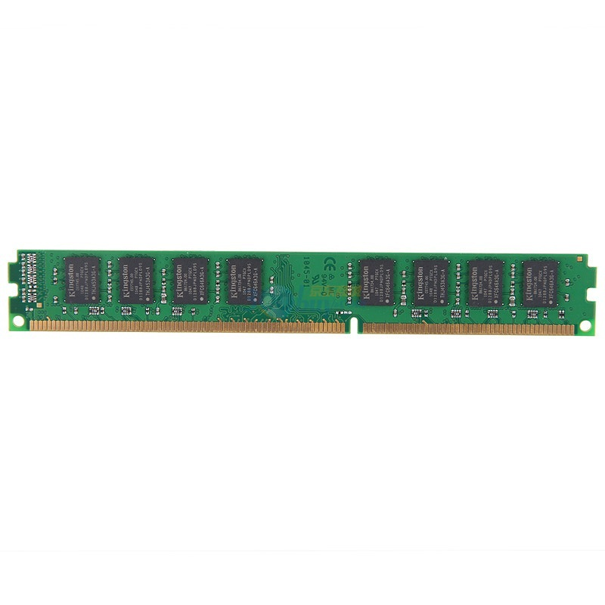
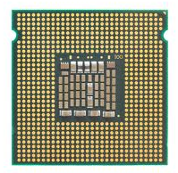
Solution-1: Shadow Paging
Guest VM
GVA
GVA
GPT
GPA
GPA
HPT
SPT
HPA
HPA
CR3

Slide 39
Two Page Tables Become One
VMM intercepts guest OS setting the virtual CR3
VMM iterates over the guest page table, constructs a corresponding shadow page table
In shadow PT, every guest physical address is translated into host physical address
Finally, VMM loads the host physical address of the shadow page table

Slide 40
Setup Shadow Page Table
set_cr3 (guest_page_table):
for GVA in 0 to 220
if guest_page_table[GVA] & PTE_P:
GPA = guest_page_table[GVA] >> 12
HPA = host_page_table[GPA] >> 12
shadow_page_table[GVA] = (HPA<<12)|PTE_P
else
shadow_page_table = 0
CR3 = PHYSICAL_ADDR(shadow_page_table)

Slide 41
Question
Assume that:
  There are 10 VMs running on a machine
  Each VM contains 10 applications
Q: how many shadow page tables in total?
  Shadow page tables are per application
  Guest page tables are per application
  Host page tables are per VM

Slide 42
What if Guest OS Modifies its Own Page Table?
It will have no effect!
  Since CR3 is now pointing to the shadow page table
  Need to synchronize the shadow page table with guest page table
Solution
  VMM needs to intercept when guest OS modifies page table, and updates the shadow page table accordingly
  Mark the guest table pages as read-only (in the shadow page table)
  If guest OS tries to modify its page tables, it triggers page fault
  VMM handles the page fault by updating shadow page table

Slide 43
What if a Guest App Access its Kernel Memory?
Remember that now the kernel is running in user mode
  It means any application may also access guest kernel's memory
  How do we selectively allow / deny access to kernel-only pages?
One solution: split a shadow page table to two tables
  Two shadow page tables, one for user, one for kernel
  When guest OS switches to user mode, VMM will switch the shadow page table as well, vice versa
  Recall trap & emulate

Slide 44
Two Memory Views of Guest VM
When guest OS
is running
When application
is running
Kernel space
No user access
User space
User access

Slide 45
The Same Question
Assume that:
  There are 10 VMs running on a machine
  Each VM contains 10 applications
Q: now, how many shadow page tables in total?

Slide 46
Sol-2: Direct Paging (Para-virtualization)
Modify the guest OS
  No GPA is needed, just GVA and HPA
  Guest OS directly manages its HPA space
  Use hypercall to let the VMM update the page table
  The hardware CR3 will point to guest page table
VMM will check all the page table operations
  The guest page tables are read-only to the guest

Slide 47
Sol-2: Direct Paging (Para-virtualization)
Positive
  Easy to implement and more clear architecture
  Better performance: guest can batch to reduce trap
Negatives
  Not transparent to the guest OS
  The guest now knows much info, e.g., HPA
    May use such info to trigger rowhammer attacks

Slide 48
Sol-3: Hardware Supported Memory Virtualization
Hardware implementation
  Intel's EPT (Extended Page Table)
  AMD's NPT (Nested Page Table)
Another table
  EPT for translation from GPA to HPA
  EPT is controlled by the hypervisor
  EPT is per-VM

Slide 49
Guest VM
VMM
GVA
PT
GPA
VA
EPT
PT
HPA
PA
Non-root mode
Root mode

Slide 50
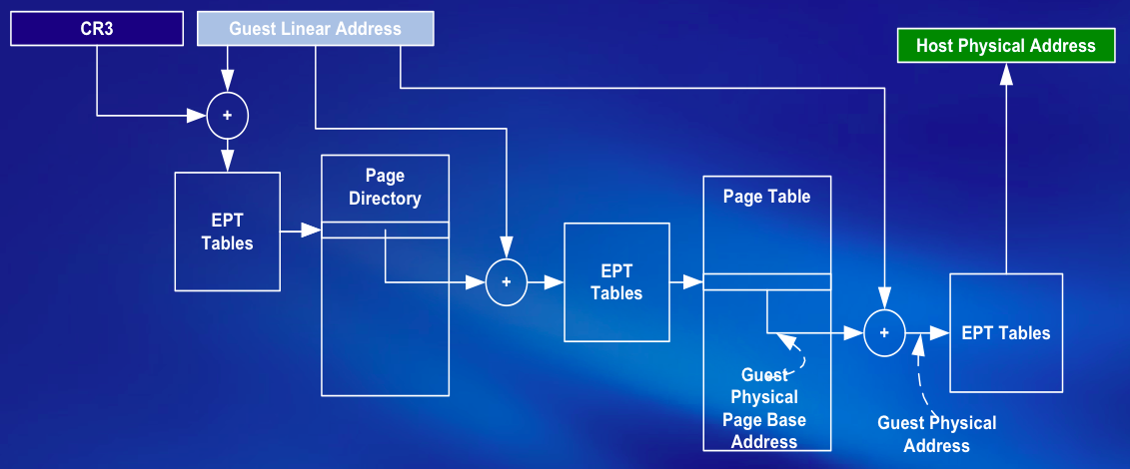
EPT Translation: Details

Slide 51
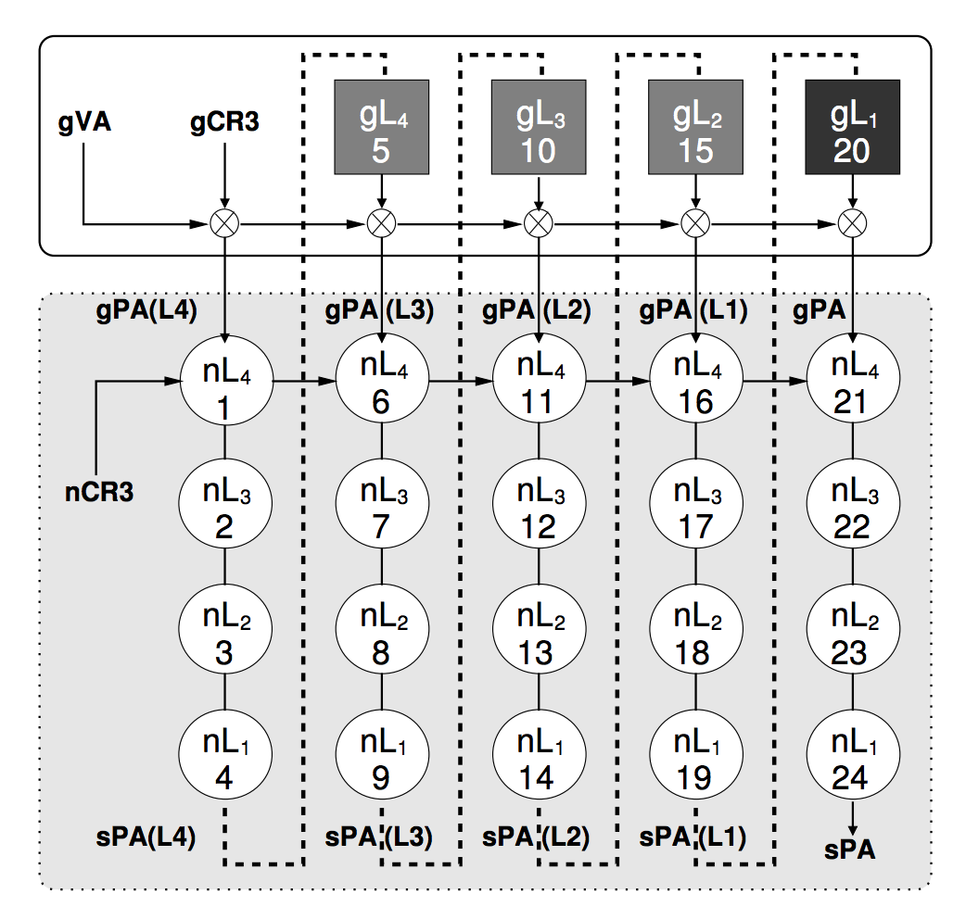
EPT Increases Memory Access
sPA == HPA
nCR3 == hCR3
nL₁ == hL₁
One memory access from the guest VM may lead up to 20 memory accesses!

Slide 52
I/O Virtualization

Slide 53
I/O Virtualization
Goal
  Multiplexing device to guest VMs
Challenges
  Each guest OS has its own driver
  How can one device be controlled by multiple drivers?
  What if one guest OS tries to format its disk?

Slide 54
Solutions for I/O Virtualization
Direct access: VM owns a device exclusively
Device emulation: VMM emulates device in software
Para-virtualized: split the drivers to guest and host
Hardware assisted: self-virtualization device

Slide 55
Sol-1: Direct Access Device Virtualization
VM
Guest OS
CPU
Memory
MMU
Controller
Local Bus
Interface
High-Speed
I/O Bus
NIC
Controller
Bridge
Frame Buffer
LAN
Low-Speed
I/O Bus
CD-ROM
USB

Slide 56
IOMMU: Page Tables for Devices
Allow guest OS direct access to underlying device
  Guest just reuses its own device driver
Q: What if a VM asks device to access memory of other VMs?
  It is possible because device accesses HPA in DMA
  Thus a device can access any memory
Solution: Page tables for devices
  Another MMU: IOMMU for devices
  Q: what addresses will IOMMU translate?

Slide 57
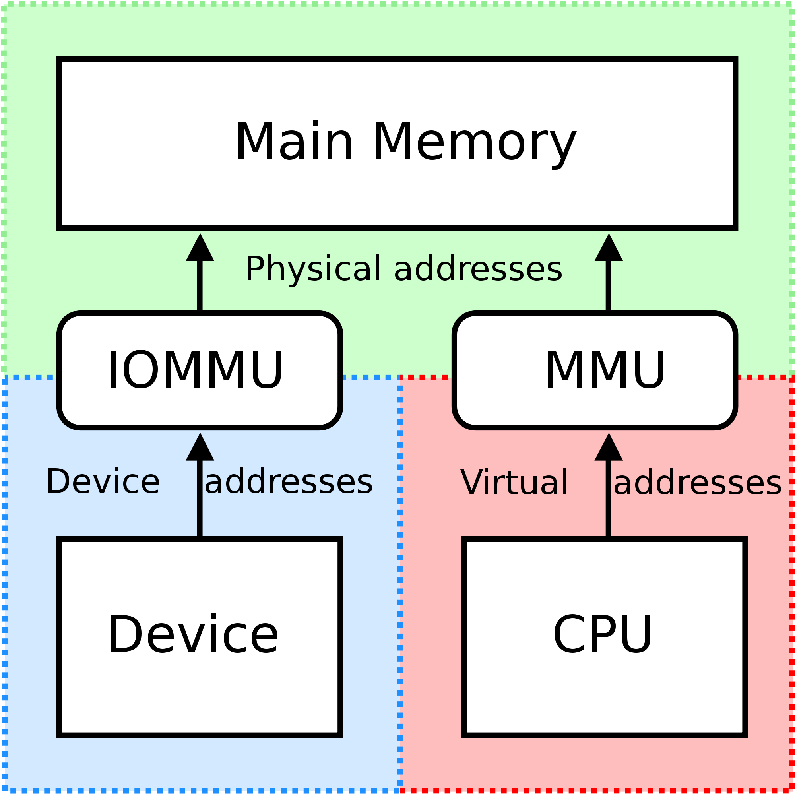
IOMMU for Direct Access
VT-d architecture defines a multi-level page-table structure for DMA address translation
Similar to IA-32 processor page-tables, enabling software to manage memory at 4 KB or larger page granularity

Slide 58
Direct Access Device Virtualization
VM
Guest OS
CPU
Memory
MMU
Controller
Local Bus
Interface / IOMMU
High-Speed
I/O Bus
NIC
Controller
Bridge
Frame Buffer
LAN
Low-Speed
I/O Bus
CD-ROM
USB

Slide 59
Direct Access Device Virtualization
Positives
  Fast, since the VM uses device just as native machine
  Simplify monitor: limited device drivers needed
Negatives
  Hardware interface visible to guest (bad for migration)
  Interposition is hard by definition (no way to trap & emulate)
  Now you need much more devices! (image 100 VMs)

Slide 60
Sol-2: Emulating Devices
Emulate a device
  Implement device logic in pure software
  Can even emulate non-existing devices
For example
  VMware emulates a 8139 network card for VMs
  Since 8139 is widely used, almost every OS has its driver
  So no need to write a new driver

Slide 61
Example: Emulating Serial Port
Device Emulator
Guest
Serial Chip
ABC
Emulation
Serial Chip
ABC
Driver
Generic Serial Layer
Host OS
Monitor
Serial Chip XYZ
LAN

Slide 62
Emulated Devices
Positives
  Platform stability (good for migration)
  Allows interposition
  No special hardware support is needed
Negatives
  Can be slow (it’s software emulated)

Slide 63
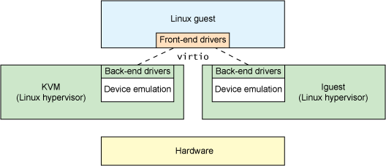
Sol-3: Para-Virtualized Devices
VMM offers new types of device
  The guest OS will run a new driver (front-end driver)
  The VMM will run a back-end driver for each front-end
  The VMM will finally run device driver to drive the device
VirtIO Architecture by KVM

Slide 64
Sol-4: Hardware Support for I/O Virtualization
VMM
  An SR-IOV-capable device can be configured to appear in the PCI configuration space as multiple functions
VM
  The VMM assigns one or more VFs to a VM by mapping the actual configuration space of the VFs to the configuration space presented to the virtual machine by the VMM

Slide 65
Guest Domain
Guest Domain
Domain-0
Application
Application
User-level Config
TCP/IP Stack
TCP/IP Stack
Device Driver (VF)
Device Driver (VF)
Device Driver (PF)
Xen
Hardware
VF
VF
VF
VF
PF
Physical Device

Slide 66

Intel Virtualization Technology Evolution
Standards for IO-device sharing:
Multi-Context I/O Devices
Endpoint Address Translation Caching
Under definition in the PCI-SIG* IOVWG
Vector 3:
I/O Focus
PCI-SIG
Vector 2:
Platform Focus
Hardware support for IO-device virtualization
Device DMA remapping
Direct assignment of I/O devices to VMs
Interrupt Routing and Remapping
VT-d
VT-x
Establish foundation
for virtualization in the
IA-32 and
Itanium architectures…
… followed by on-going evolution of support:
Micro-architectural (e.g., lower VM switch times)
Architectural (e.g., Extended Page Tables)
Vector 1:
Processor Focus
VT-i
VMM
Software
Evolution
Software-only VMMs
Binary translation
Paravirtualization
Simpler
and more Secure
VMM through
foundation
of virtualizable ISAs
Increasingly better CPU and I/O virtualization
performance and functionality as I/O devices
and VMMs exploit infrastructure provided
by VT-x, VT-i, VT-d
Past
No Hardware
Support
Today
VMM software evolution over time with hardware support

Slide 67
Virtualization Technologies
Virtualization | Software Solution | Hardware Solution
CPU | Trap & Emulate Instruction interpretation Binary translation | VT-x Root / non-root mode VMCS
 | Para-virtualization: Replace 17 insns
Memory | Shadow page table Separating page tables for U/K | EPT
 | Para-virtualization: Direct paging
Device | Direct I/O Device emulation | IOMMU SR-IOV
 | Para-virtualization: Front-end & back-end driver (e.g., virtio)

